Slide 1
Computer Networks _22CS008
Application Layer: DNS, Email, Remote Logging
Lecture 58
Prepared by
Dr. Mankirat Kaur
Department of Computer Science and Engineering,
Chitkara University, Punjab
Computer Networks
Notes:
‹#›

Slide 2
Index
Application Layer
DNS
Electronic Mail
SMTP
Remote Logging
TELNET
Computer Networks
Notes:
‹#›

Slide 3
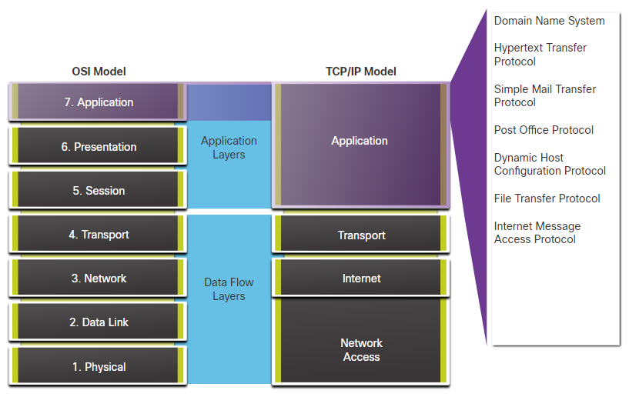
Application Layer
The application layer sits at Layer 7, the top of the Open Systems Interconnection (OSI) communications model. It ensures an application can effectively communicate with other applications on different computer systems and networks.
The application layer is not an application. Instead, it is a component within an application that controls the communication method to other devices. It is an abstraction layer service that masks the rest of the application from the transmission process.
Fig. 1 Application Layer
Computer Networks
Notes:
‹#›

Slide 4
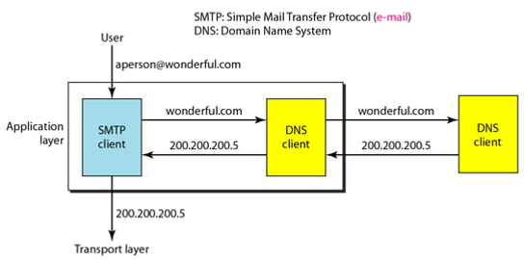
DNS: Domain Name Server
DNS is a hostname for IP address translation service. DNS is a distributed database implemented in a hierarchy of name servers. It is an application layer protocol for message exchange between clients and servers.
NEED OF DNS:
Every host is identified by the IP address but remembering numbers is very difficult for the people also the IP addresses are not static therefore a mapping is required to change the domain name to the IP address. So DNS is used to convert the domain name of the websites to their numerical IP address.
Fig. 2 Example of using the DNS service
Computer Networks
Notes:
‹#›

Slide 5
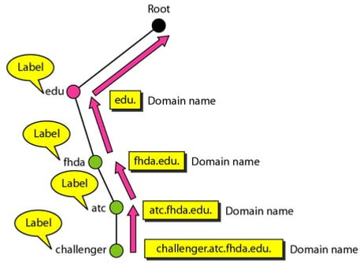
NAME SPACE
To be unambiguous, the names assigned to machines must be carefully selected from a name space with complete control over the binding between the names and IP addresses.
A name space that maps each address to a unique name can be organized in two ways:
Flat Name Space: A name in this space is a sequence of characters without structure.
Hierarchical Name Space: Each name is made of several parts. The first part can define the nature of the organization, the second part can define the name of an organization, the third part can define departments in the organization, and so on.
Fig. 3 Hierarchical Domain Name Space
Computer Networks
Notes:
‹#›

Slide 6
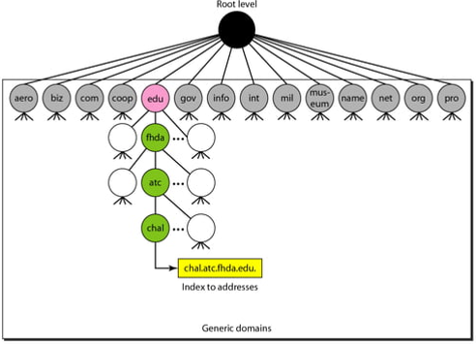
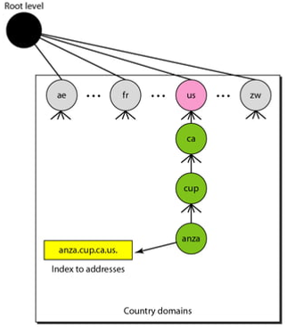
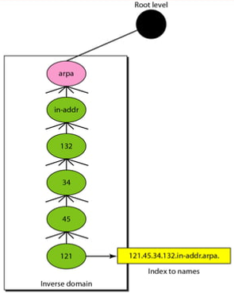
Sections of Domain Name Space
Different kind of Domains:-
Generic domain: The generic domains define registered hosts according to their generic behavior. For example, .com (commercial) .edu (educational) .mil (military) .org (non profit organization) .net (similar to commercial) all these are generic domain. This section allows 14 possible labels.
Country domain: The country domains section uses two-character country abbreviations (e.g., us (United States), .in (India)). Second labels can be organizational, or they can be more specific, national designations. The address anza.cup.ca.us can be translated to De Anza College in Cupertino, California, in the United States.
Inverse domain: It is used to map an address to a name. This domain is used for resolving pointer or inverse query where only IP address of client is listed and DNS server map an address to a name to determine if the client is on the authorized list.
Computer Networks
Notes:
‹#›

Slide 7
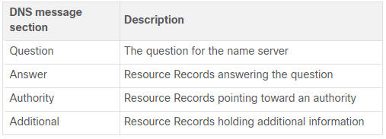
DNS Message Format
The DNS server stores different types of resource records that are used to resolve names. These records contain the name, address, and type of record. Some of these record types are as follows:
A - An end device IPv4 address
NS - An authoritative name server
AAAA - An end device IPv6 address (pronounced quad-A)
MX - A mail exchange record
DNS uses the same message format between servers, consisting of a question, answer, authority, and additional information for all types of client queries and server responses, error messages, and transfer of resource record information.
Fig. 4 DNS Message format
Computer Networks
Notes:
‹#›

Slide 8
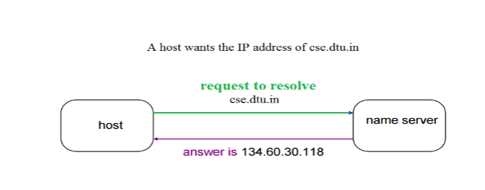
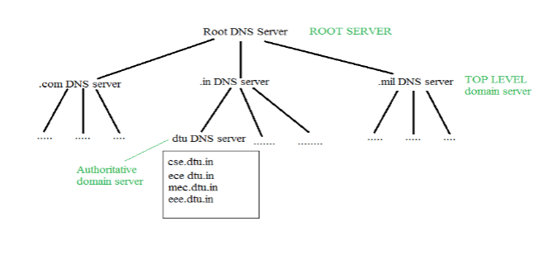
Domain Name to Address Resolution
The host requests the DNS name server to resolve the domain name. And the name server returns the IP address corresponding to that domain name to the host so that the host can future connect to that IP address. The hierarchy of Name Servers is:
Root name server: It is contacted by name servers that can not resolve the name. It contacts authoritative name server if name mapping is not known. It then gets the mapping and returns the IP address to the host.
Top level domain (TLD) server: It is responsible for com, org, edu etc and all top level country domains like uk, fr, ca, in etc. They have info about authoritative domain servers and know the names and IP addresses of each authoritative name server for the second-level domains.
Authoritative name servers are the organization’s DNS server, providing authoritative host name to IP mapping for organization servers. It can be maintained by an organization or service provider. In order to reach cse.dtu.in we have to ask the root DNS server, then it will point out to the top level domain server and then to authoritative domain name server which actually contains the IP address. So the authoritative domain server will return the associated IP address.
Fig. 5 Address resolution
Computer Networks
‹#›
Notes:
‹#›

Slide 9
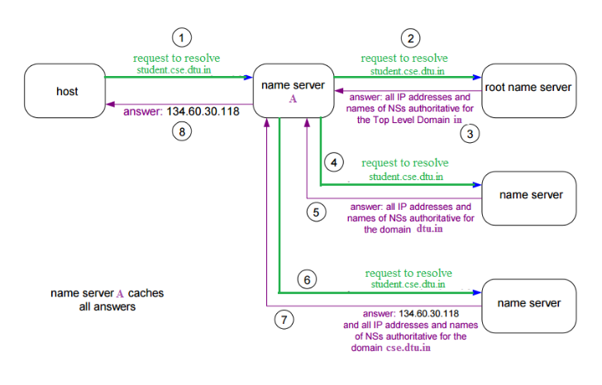
DOMAIN NAME SERVER: WORKING
The client machine sends a request to the local name server, which , if does not find the address in its database, sends a request to the root name server , which in turn, will route the query to an top-level domain (TLD) or authoritative name server.
The root name server can also contain some host name to IP address mappings. The Top-level domain (TLD) server always knows who the authoritative name server is.
So finally the IP address is returned to the local name server which in turn returns the IP address to the host.
Fig. 6 Example of DNS Address Resolution
Computer Networks

Slide 10
Electronic Mail
Electronic Mail (e-mail) is one of most widely used services of Internet. This service allows an Internet user to send a message in formatted manner (mail) to the other Internet user in any part of the world. Message in mail not only contain text, but it also contain images, audio and videos data. The person who is sending mail is called sender and person who receives mail is called recipient. It is just like postal mail service.
Components of E-Mail System :
The basic components of an email system are :
User Agent (UA), Message Transfer Agent (MTA), Mail Box, and Spool file.
These are explained as following below:
User Agent (UA) : The UA is normally a program which is used to send and receive mail. Sometimes, it is called as mail reader. It accepts variety of commands for composing, receiving and replying to messages as well as for manipulation of the mailboxes.
Message Transfer Agent (MTA) : MTA is actually responsible for transfer of mail from one system to another. To send a mail, a system must have client MTA and system MTA. It transfer mail to mailboxes of recipients if they are connected in the same machine. It delivers mail to peer MTA if destination mailbox is in another machine. The delivery from one MTA to another MTA is done by Simple Mail Transfer Protocol (SMTP).
Computer Networks

Slide 11
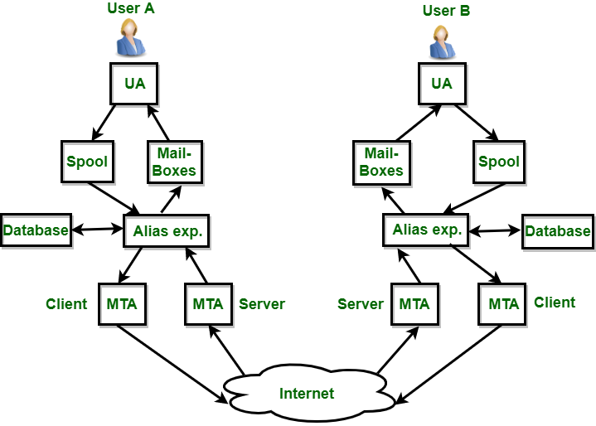
Electronic Mail
3. Mailbox : It is a file on local hard drive to collect mails. Delivered mails are present in this file. The user can read or delete it according to his/her requirement. To use e-mail system each user must have a mailbox . Access to mailbox is given only to the owner of the mailbox.
4. Spool file : This file contain mails that are to be sent. User agent appends outgoing mails in this file using SMTP. MTA extracts pending mail from spool file for their delivery.
E-mail allows one name, an alias, to represent several different e-mail addresses.
It is known as mailing list, Whenever user have to sent a message, system checks recipient’s name against alias database. If mailing list is present for defined alias, separate messages, one for each entry in the list, must be prepared and handed to MTA. If for defined alias, there is no such mailing list is present, name itself becomes naming address and a single message is delivered to mail transfer entity.
Fig. 7 Example of Email System
Computer Networks

Slide 12
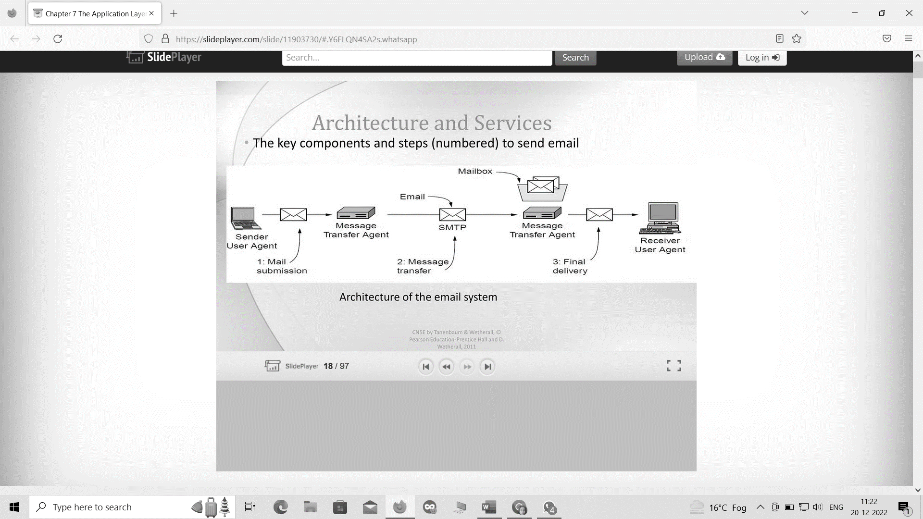
Architecture of Email System
Fig. 8 Architecture of the email system
Computer Networks

Slide 13

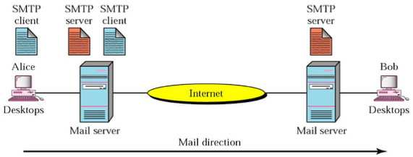
Simple Mail Transfer Protocol (SMTP)
The formal protocol that defines the MTA client and server in the Internet is called the Simple Mail Transfer Protocol (SMTP). SMTP simply defines how commands and responses must be sent MTA client and an MTA server.
Commands are sent from the client to the server. The format of a command is:
It consists of a keyword followed by zero or more arguments. SMTP defines 14 commands.
Responses are sent from the server to the client. A response is a three digit code that may be followed by additional textual information.
Fig. 9 SMTP
Computer Networks

Slide 14
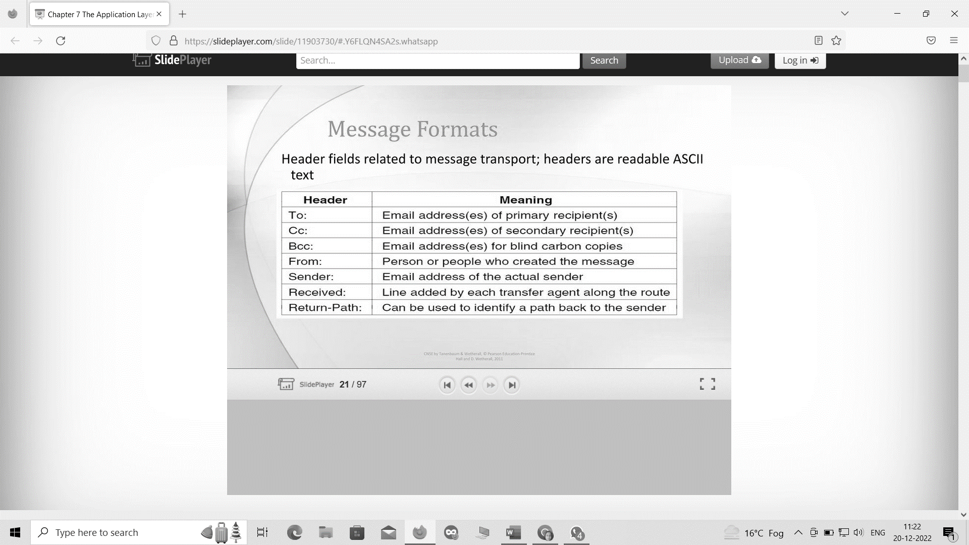
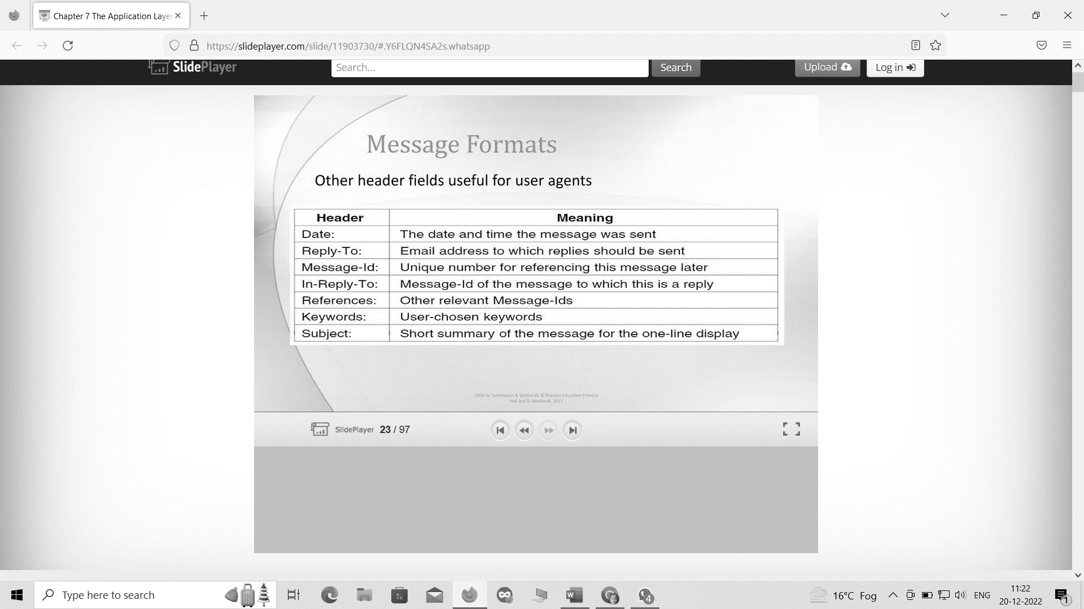
Message Formats
Fig. 10 Message Formats of Email System
Computer Networks

Slide 15
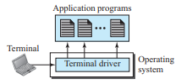
Remote Logging: TELNET
The main task of the internet is to provide services to users. For example, users want to run different application programs at the remote site and transfers a result to the local site. This requires a client-server program such as FTP, SMTP. But this would not allow us to create a specific program for each demand.
The better solution is a general-purpose client/server program that lets a user access any application program on a remote computer; i.e., allow the user to log on to a remote computer.
TELNET is the standard TCP/IP protocol for virtual terminal service as proposed by the International Organization for Standards (ISO).
TELNET is an abbreviation for TErminaL NETwork. It enables the establishment of a connection to a remote system in such a way that the local terminal appears to be a terminal at the remote system.
It provides a connection to the remote computer in such a way that a local terminal appears to be at the remote side.
The local logging process can be shown as:
Computer Networks

Slide 16
How remote login occurs ?
The process of remote login using TELNET protocol can be described as:
At the local site
The user sends the keystrokes to the terminal driver, the characters are then sent to the TELNET client. The TELNET client which in turn, transforms the characters to a universal character set known as network virtual terminal characters and delivers them to the local TCP/IP stack
At the remote site
The commands in NVT forms are transmitted to the TCP/IP at the remote machine. Here, the characters are delivered to the operating system and then pass to the TELNET server. The TELNET server transforms the characters which can be understandable by a remote computer.
However, the characters cannot be directly passed to the operating system as a remote operating system does not receive the characters from the TELNET server. Therefore it requires some piece of software that can accept the characters from the TELNET server.
The operating system then passes these characters to the appropriate application program.
Computer Networks

Slide 17
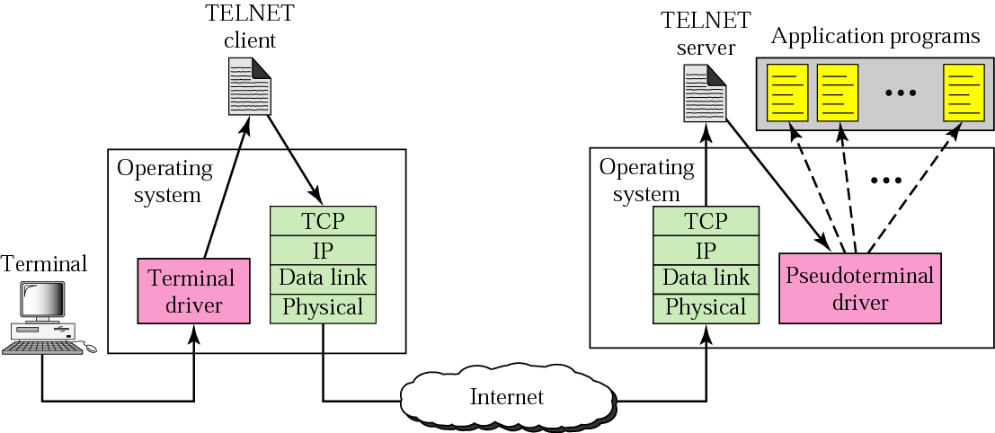
TELNET
Fig. 11 Remote Login in TELNET
Computer Networks

Slide 18
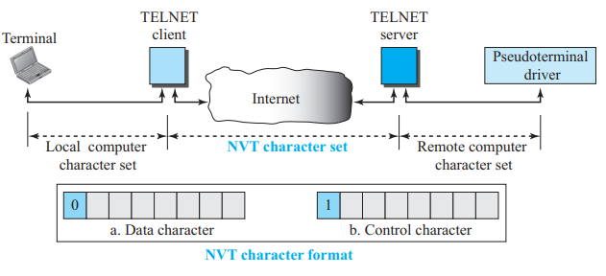
Network Virtual Terminal (NVT)
The network virtual terminal is an interface that defines how data and commands are sent across the network.
TELNET solves this issue by defining a universal interface known as network virtual interface.
The TELNET client translates the characters that come from the local terminal into NVT form and then delivers them to the network. The Telnet server then translates the data from NVT form into a form which can be understandable by a remote computer.
Fig. 12 Network Virtual Terminal
Computer Networks

Slide 19
Network Virtual Terminal (NVT)
NVT Character Set NVT uses two sets of characters, one for data and the other for control.
Both are 8-bit bytes. For data, NVT is an 8-bit character set in which the 7 lowest-order bits are the same as ASCII and the highest-order bit is 0.
To send control characters between computers (from client to server or vice versa), NVT uses an 8-bit character set in which the highest-order bit is set to l.
Computer Networks

Slide 20
Practice Questions
A DNS server that receives a request for a name resolution that is not within its DNS zone will send a failure message to the requesting client. True or False?
True
False
Which of the following statements is incorrect with respect to writing e-mails?
We cannot add more than one address in the ‘To’ field
We cannot leave the ‘Bcc’ field blank
We cannot leave the ‘Cc’ field blank
The ‘To’ and ‘Cc’ fields are often used interchangeably.
Which of the following is mandatory for sending an email?
Body
Sender mail ID
Attachment
Subject
Computer Networks

Slide 21
References
Books:
Data Communications and Networking’ by Forouzan, 5th Edition, 2013.
Computer Networks’ By Andrew S. Tanenbaum 5th Edition, Pearson Education,2013.
Data and Computer Communications’ by William Stallings, 8th Edition, Pearson,2007.
E-Resources:
CISCO Networking Academy
https://library.chitkara.edu.in/subscribed-books.php
Computer Networks

